Slide 1
CSAMA 2023: Bulk RNA-seq introduction
https://bit.ly/csama-rna-seq-intro
Michael Love
Genetics Department Biostatistics Department
UNC-Chapel Hill
Notes:
biology of transcription, quantification, batch effects and QC
don't cover:
types of DE, modeling counts, scaling, transcript lengths, parameter estimation
https://docs.google.com/presentation/d/1-xxPxbi9VUVRBCTnoHeEjHvIPWTiOgNSKCKp6oJXibs/edit#slide=id.p3

Slide 2
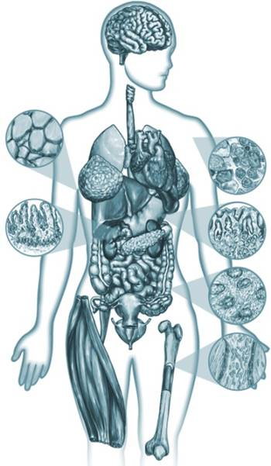

Gene expression
Dynamic across time, tissue, individuals
Measurement is harder than for the genome
[Roadmap Epigenomics Project]
Notes:
“Gene expression is the transcription of genomic DNA into RNA”
“I’ve been analyzing gene expression data for 8 years, developing methods for 4 years”
“While genome is nearly constant within an individual…”

Slide 3

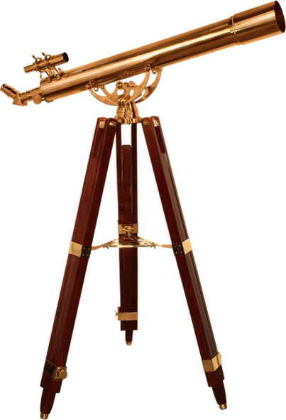
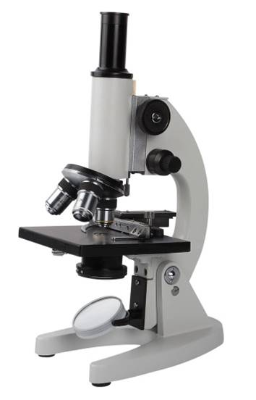
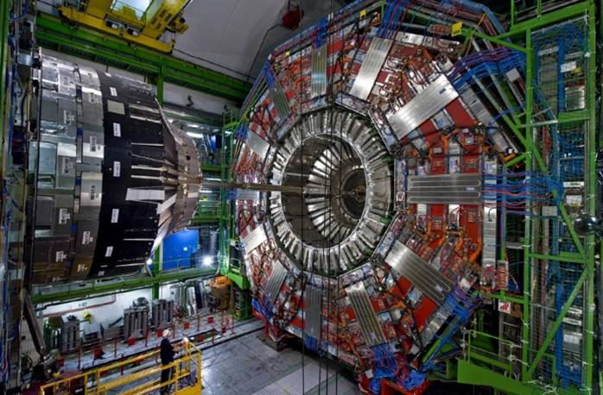
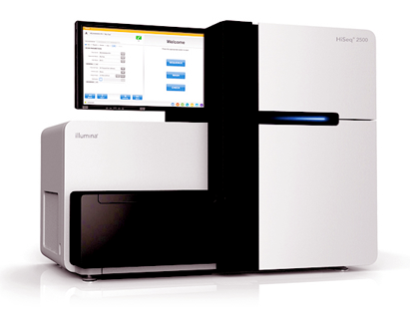
Why gene expression?
Basic biology: transcription, translation, RNA enzyme
As a phenotype: easier to measure than proteins
Research: find interesting genetic loci
Diagnostic: classify cancer subtypes
New and better measuring devices drive discovery
(2007)
Notes:
“one example of this is…”

Slide 4
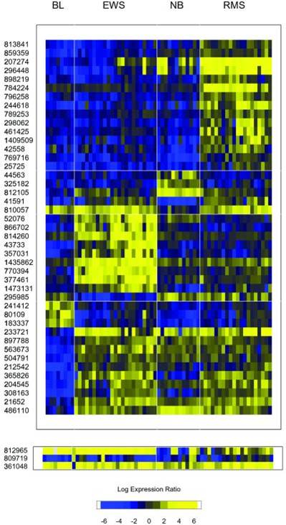
Statistical analysis of gene expression
Alternatively: Northern blot, qPCR
Era of microarrays, now sequence
Clustering, differential expression
Marginal testing, simple enough
Statistical methods offer benefit
Key insight about expression data:
Costly, often few replicates (n=3-5)
Many genes over which to estimate parameters
Tibshirani et al (2002)
Notes:
“…per gene variances…”

Slide 5
Lab: what is airway transcriptome response to glucocorticoid hormone?
four human donors
extract mRNA
control
treat with
dexamethasone
airway epithelial cells

Slide 6
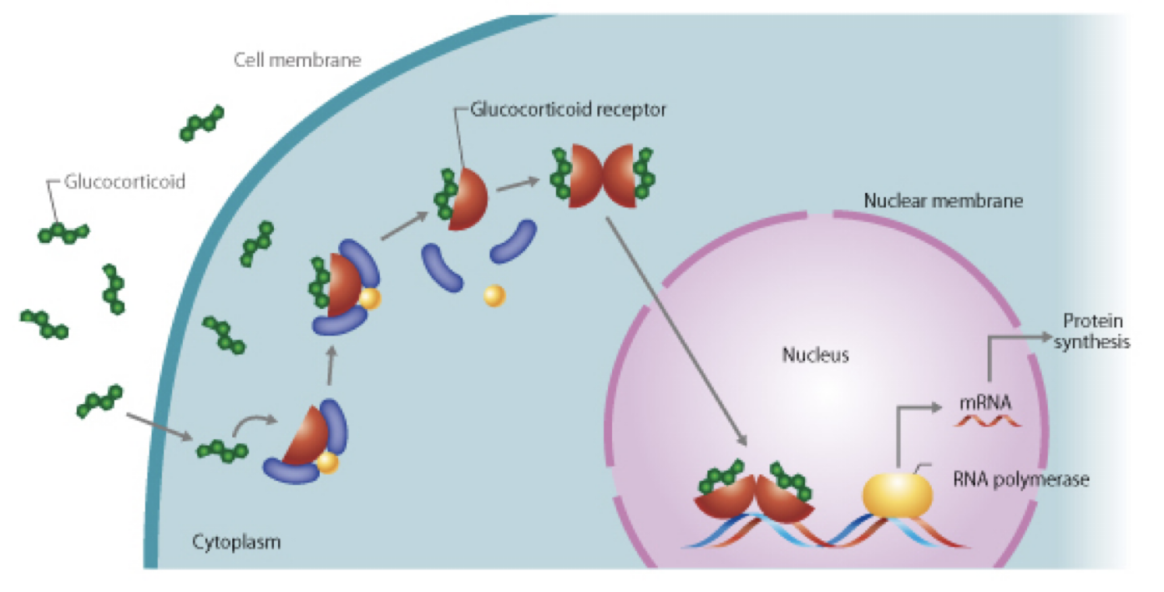
Glucocorticoid mechanism of action
transcription factor
hormone
cis regulatory element (CRE)
CSLS / University of Tokyo http://csls-text3.c.u-tokyo.ac.jp/

Slide 7
Compare gene expression across treatment, within cell line
cDNA libraries
control
Visualize differences between samples
Test for differences in gene expression, one gene at a time
Visualize differences across all genes
treated with
dexamethasone

Slide 8
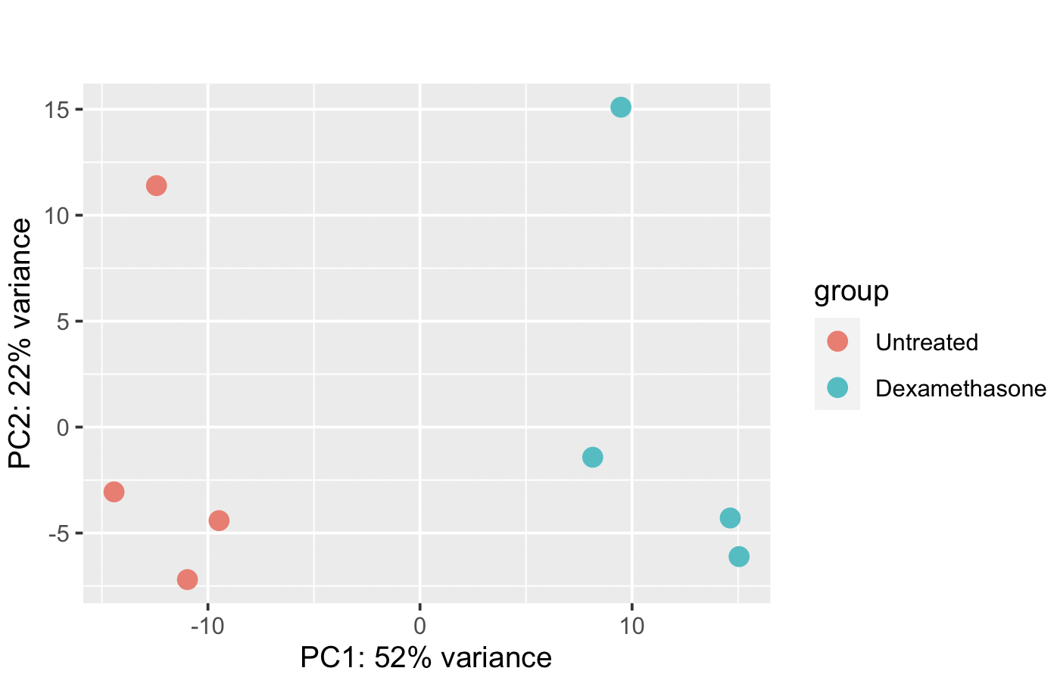
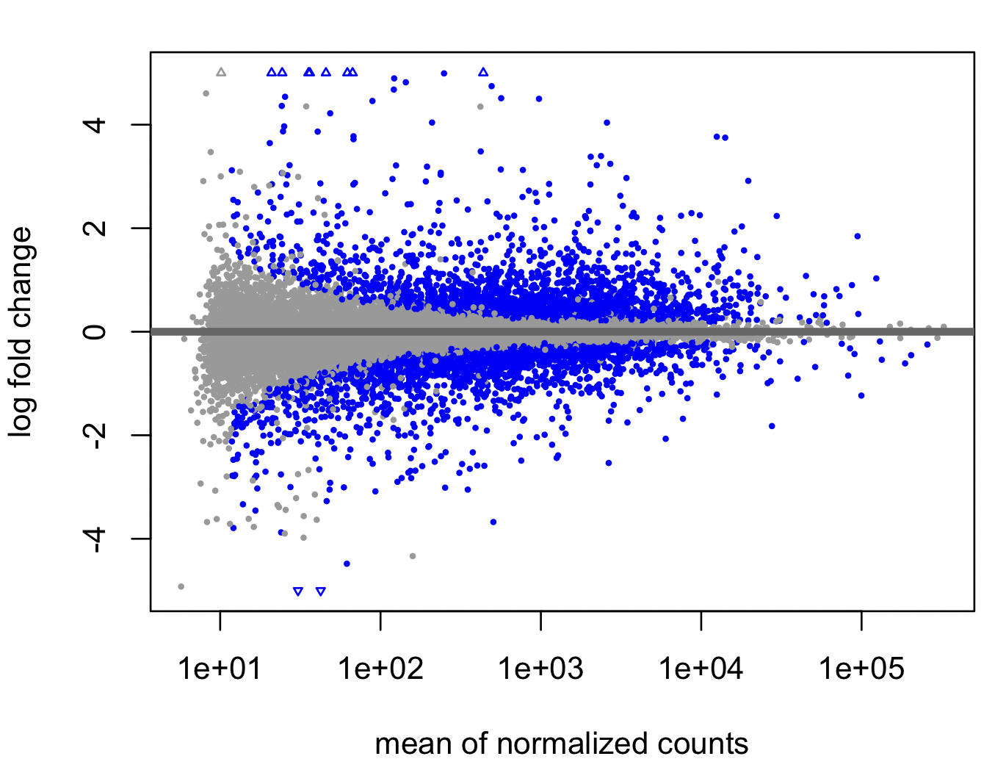
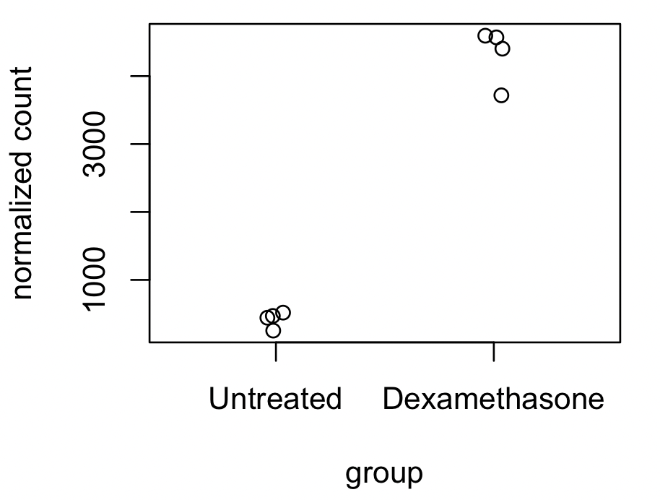
Compare gene expression across treatment, within cell line
cDNA libraries
PCA plot
control
MA plot
Counts plot
treated with
dex.

Slide 9
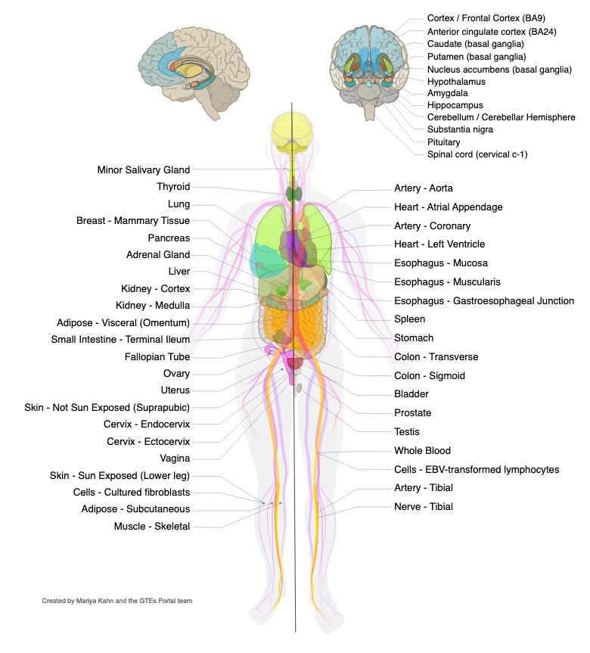

Does it make sense to do DE across tissues?

Slide 10
Biology intro
RNA-seq count table
Batch effects and QC
Quantification (reads → count table)
Import into Bioconductor

Slide 11
Who has what?
prokaryote
eukaryote
 | Bacteria | Single cell fungus | Plant | Animal
Cell wall | ✅ | ✅ | ✅ (rigid) | ✅
Nucleus | 🚫 | ✅ | ✅ | ✅
Splicing | 🚫 | 🚫 | ✅ | ✅
Mitochondria | 🚫 | ✅ | ✅ | ✅
Photosynthesis | ✅ | 🚫 | ✅ | 🚫
Chromosomes | circular | linear | linear | linear
Meiosis (sex) | 🚫 | sometimes | ✅ | ✅
Horizontal gene transfer | ✅ | 🚫 | 🚫 | 🚫
?
?
?

Slide 12
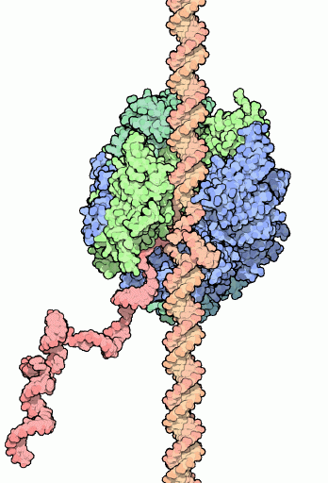
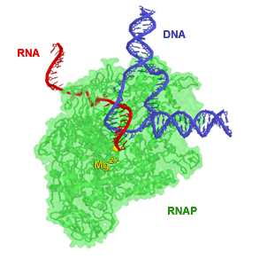
RNA polymerase = the DNA copier

Slide 13
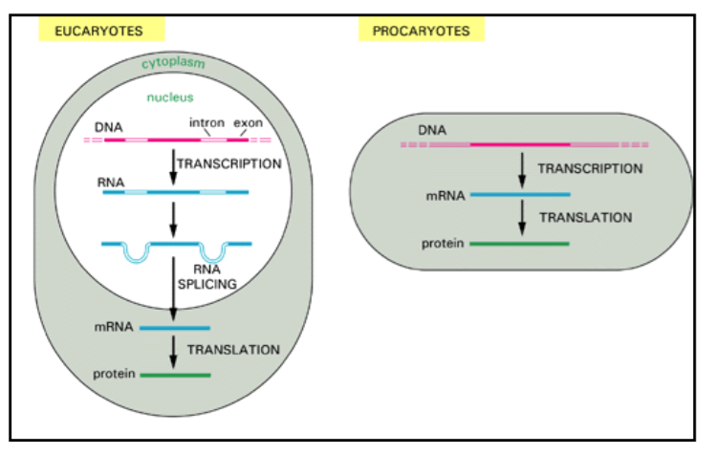

Simple diagram: transcription, splicing, & translation
Alberts et al Mol Biol of the Cell

Slide 14
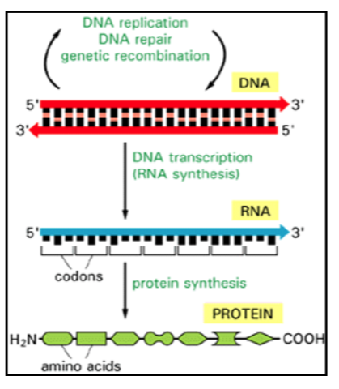
DNA → RNA → protein (usually)
By making more RNA, the cell makes more protein (usually)
Proteins can then loop back and bind to, or change the properties of DNA
This forms a regulatory network, kind of like a computer
The system can have positive and negative feedback loops, logic, memory

Slide 15
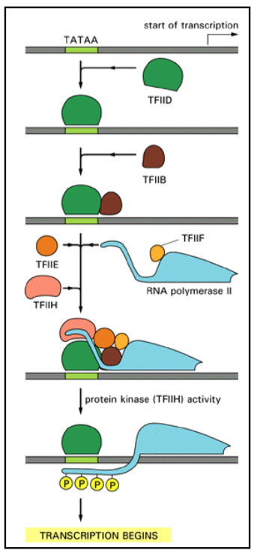
Transcription initiation involves a lot of proteins

Slide 16
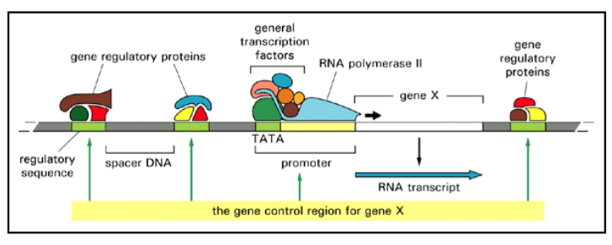
The whole picture: lots of transcription factors

Slide 17
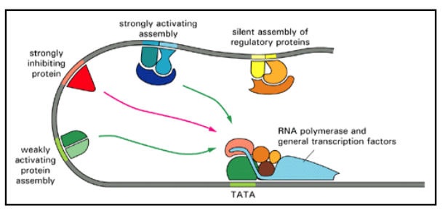
Regulatory signals are integrated

Slide 18
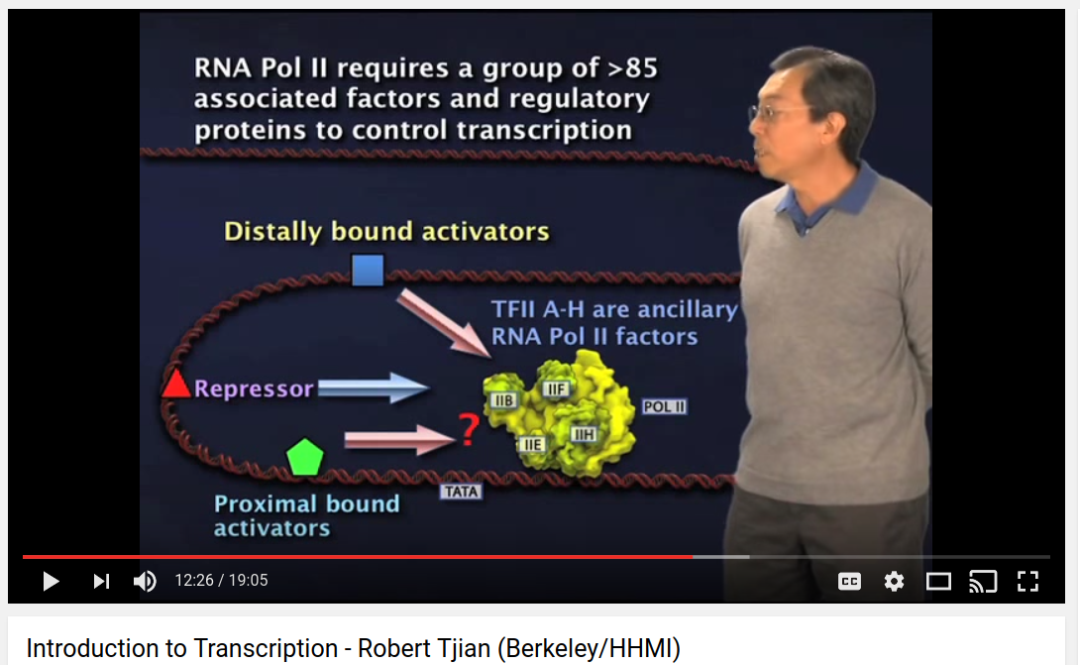
Robert Tjian (HHMI) video

Slide 19
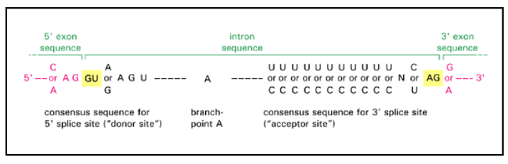
Splicing signal in the DNA sequence

Slide 20
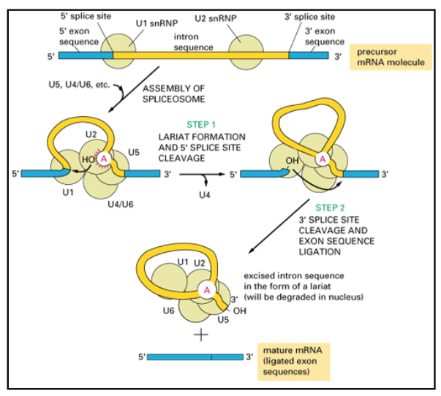
Splicing proteins (spliceosome)

Slide 21
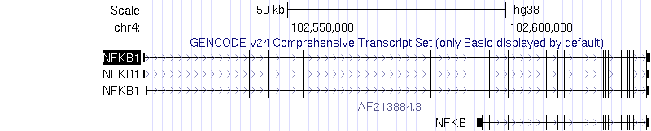
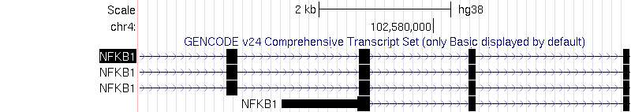
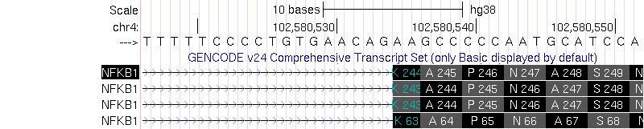
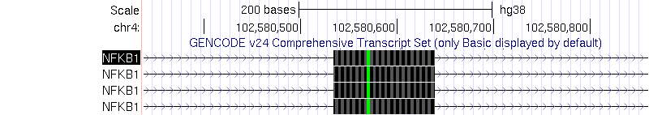
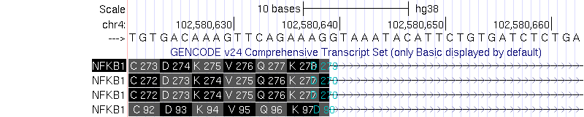
Typical gene
AG (end)
GU (begin)
Typical gene is ~100kb in genome. Only ~4kb of coding sequence.
Also often untranslated regions in beginning and end.

Slide 22
Why not protein abundance?

Slide 23
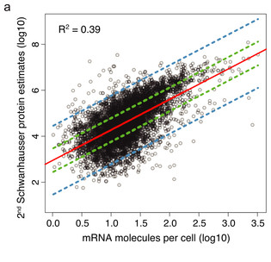
RNA and protein abundance correlation is low?
http://rajlaboratory.blogspot.com/2015/05/rna-doesnt-correlate-with-protein-huh.html

Slide 24
Have to think about steady state measurements
protein
?
translation
degradation
RNA
?
transcription
degradation
“Do mRNA and protein levels correlate across all genes?”
“If you increase the amount of mRNA, will you end up with more of the corresponding protein?”
Answer: Often, yes. Look at fold change vs fold change. Or, look at abundance changes due to genotype ("QTL")

Slide 25
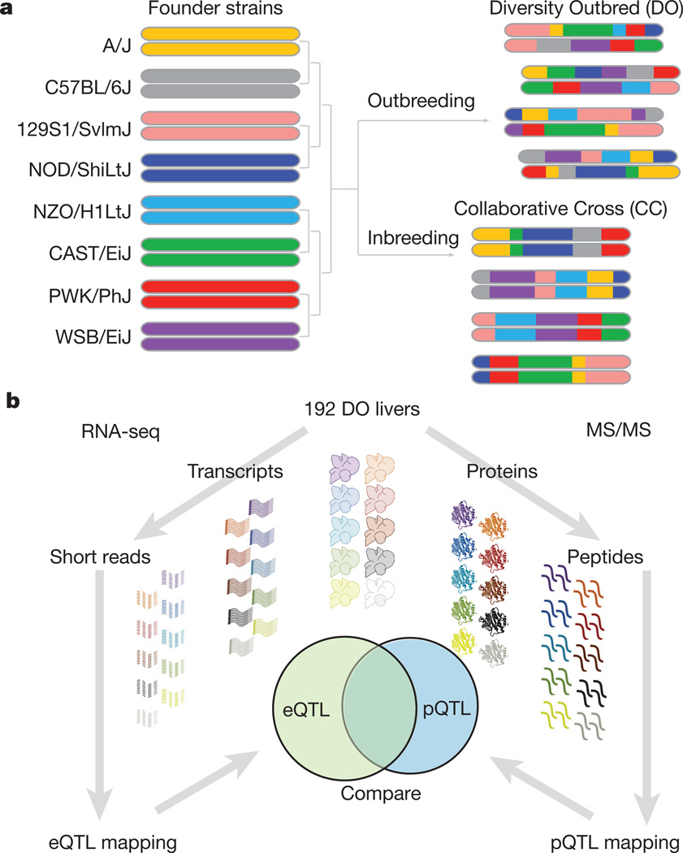
doi: 10.1038/nature18270
PMCID: PMC5292866
Defining the consequences of genetic variation on a proteome–wide scale
Joel M. Chick,* Steven C. Munger,* Petr Simecek, Edward L. Huttlin, Kwangbom Choi, Daniel M. Gatti, Narayanan Raghupathy, Karen L. Svenson, Gary A. Churchill, and Steven P. Gygi

Slide 26
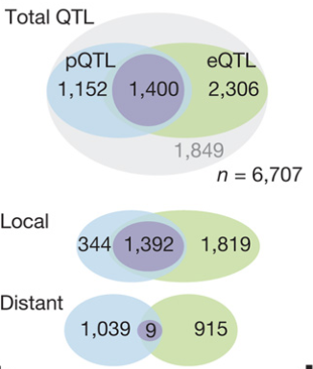
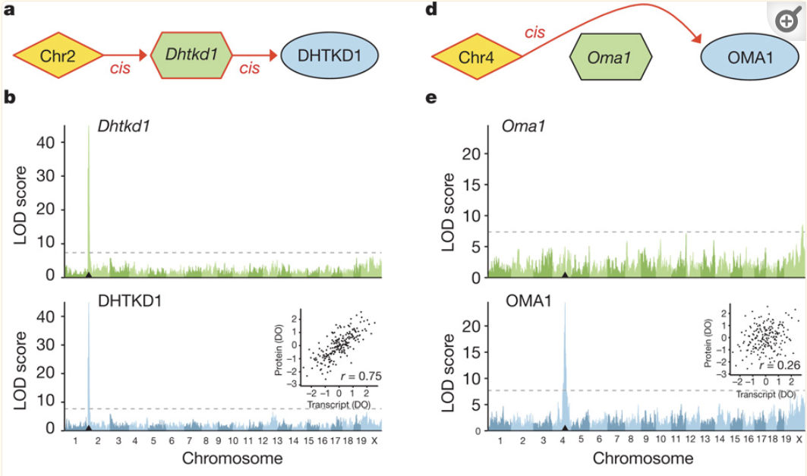
?

Slide 27
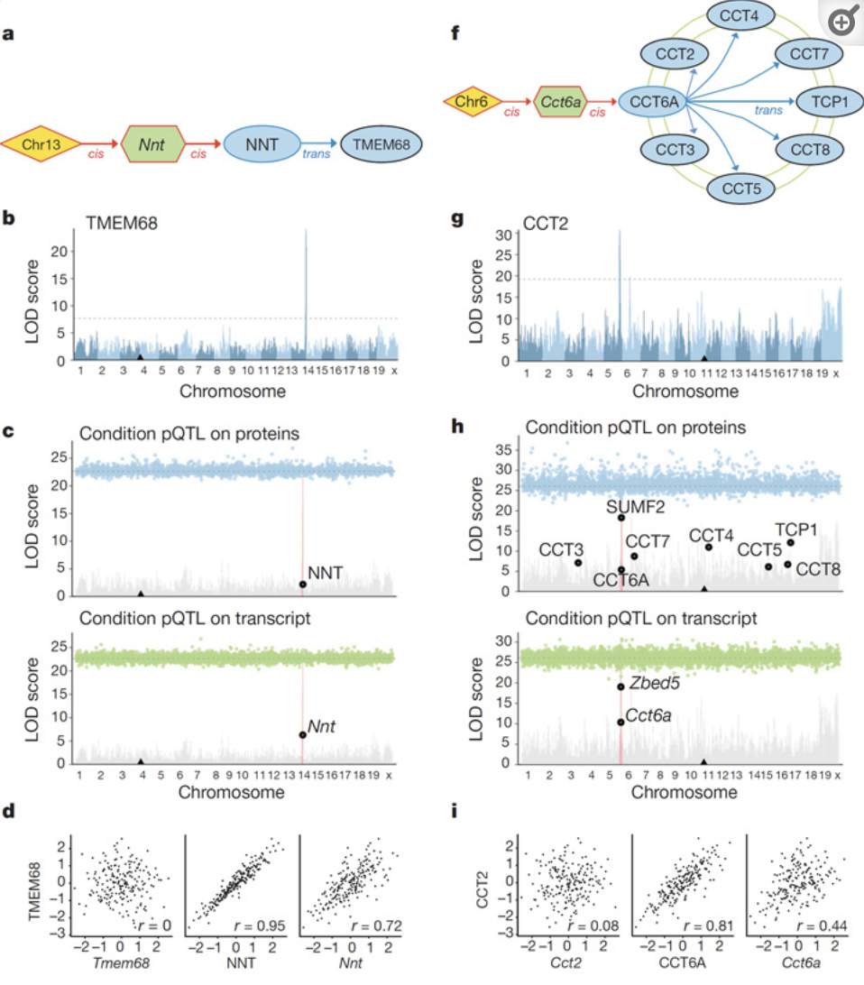
?
?

Slide 28
Biology intro
RNA-seq count table
Batch effects and QC
Quantification (reads → count table)
Import into Bioconductor

Slide 29
RNA (cDNA) short read sequencing
High dynamic range:
RNA transcript
5’
(AAA)
4 fragments
RNA fragment
fragmentation
5’
RNA / cDNA
5’
15 fragments
hexamer priming
double strand cDNA
5’
cDNA
size selection &
5’
PCR amplification
4,000 fragments
…
ACGTACGT…
sequencing: produces a “fragment”
…TTAACCGG
Gene A
pair of sequenced reads
Notes:
“As opposed to hybridization…”
“…Also we are able to discovery new transcripts, and there is other information I’ll come to later”

Slide 30
More complex
Gene: region of genome
Three “isoforms”, also called “transcripts”
genome
exon
exon
exon
exon
gene

Slide 31
mRNAs to short read fragments
colors: different genes
K_{ij} = count of fragments
aligned to gene i, sample j
is proportional to:
expression of RNA
length of gene
sequencing depth
lib. prep. factors (PCR)
in silico factors (alignment)
etc.
?
SE reads or PE fragments
mRNA transcript

Slide 32
Sequencing depth
sample 1
sample 2

Slide 33
The cDNA count table
observed data consists of counts of fragments across features (rows) and samples (columns)
more about how we count later in this lecture (htseq, featureCounts, Salmon, etc.)
samples: test differences across condition (w.r.t. biological and technical variation)
features (e.g. transcripts or genes)
SRR1039508 SRR1039509 SRR1039512 SRR1039513 SRR1039516
ENSG00000000003 679 448 873 408 1138
ENSG00000000005 0 0 0 0 0
ENSG00000000419 467 515 621 365 587
ENSG00000000457 260 211 263 164 245
ENSG00000000460 60 55 40 35 78

Slide 34
Ready to go?
Comparing these counts across samples gives the DE genes?
SRR1039508 SRR1039509 SRR1039512 SRR1039513 SRR1039516
ENSG00000000003 679 448 873 408 1138
ENSG00000000005 0 0 0 0 0
ENSG00000000419 467 515 621 365 587
ENSG00000000457 260 211 263 164 245
ENSG00000000460 60 55 40 35 78

Slide 35
Biology intro
RNA-seq count table
Batch effects and QC
Quantification (reads → count table)
Import into Bioconductor

Slide 36
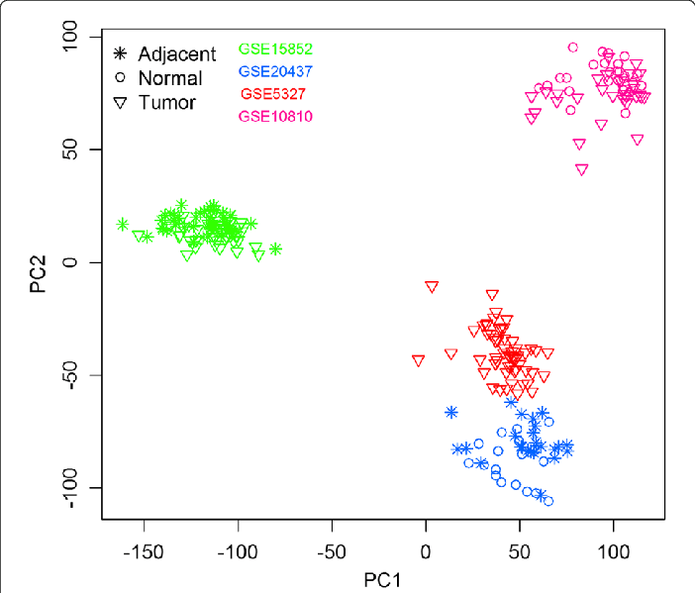
Batch effects!
Sample correlations = Factors of unwanted variation (RUV) = Surrogate variables (sva)
Impact on your results:
sample swaps / mis-labelled data
batch effects
…
…
which DE tool
colour vs color in ggplot

Slide 37


Slide 38
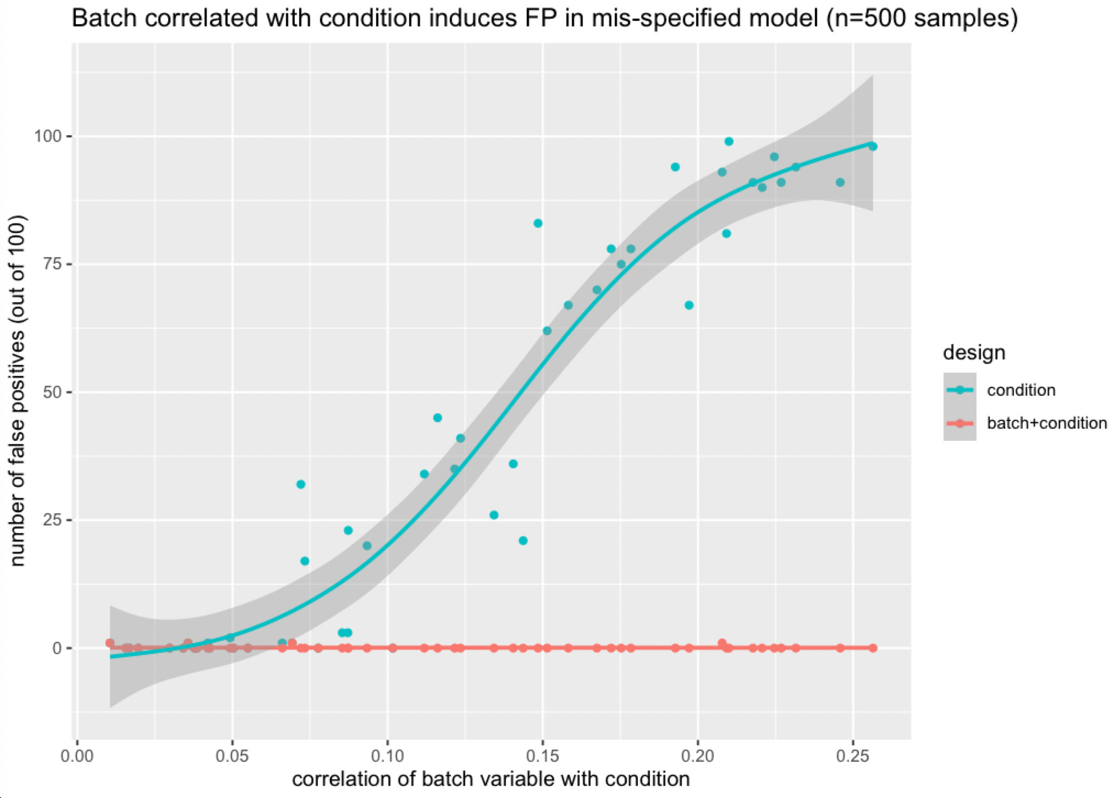
Even low correlations are a problem for large N
Notes:
https://github.com/mikelove/preNivolumabOnNivolumab

Slide 39
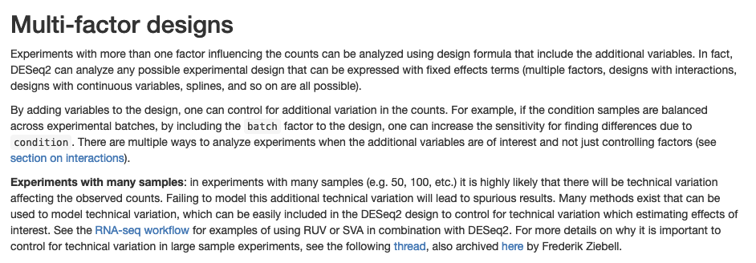
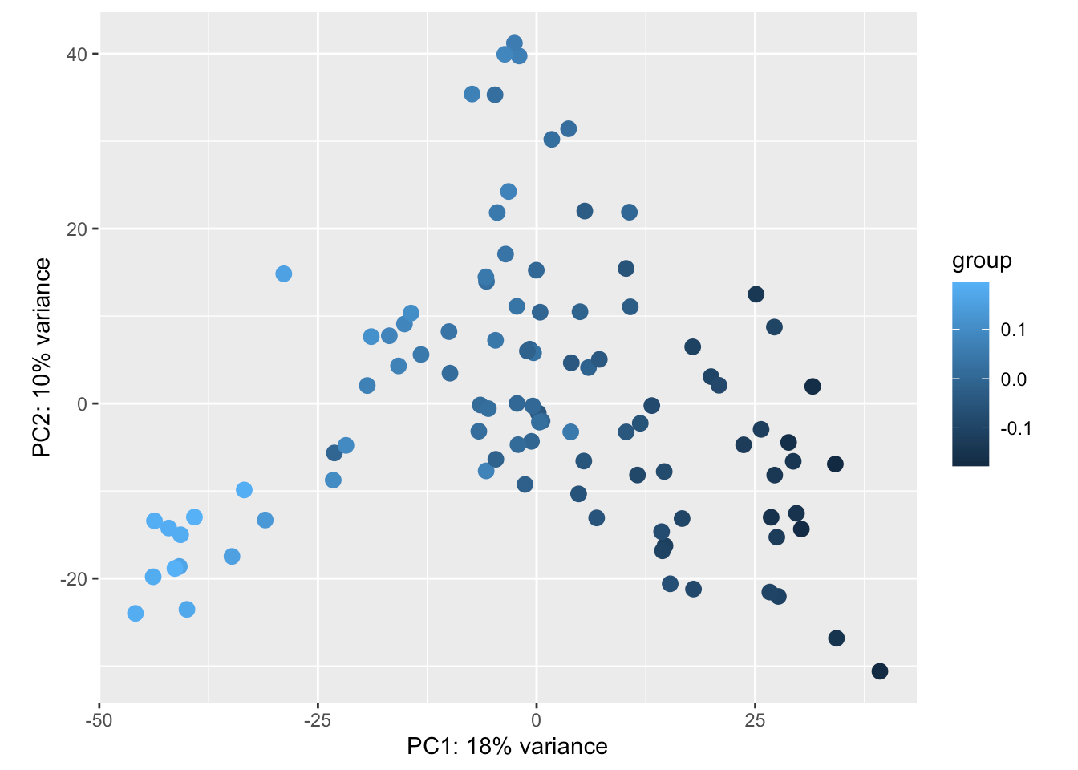

More in the DESeq2 vignette
https://bioconductor.org/packages/release/bioc/vignettes/DESeq2/inst/doc/DESeq2.html#multi-factor-designs
https://github.com/mikelove/preNivolumabOnNivolumab
"don't ignore batch"

Slide 40
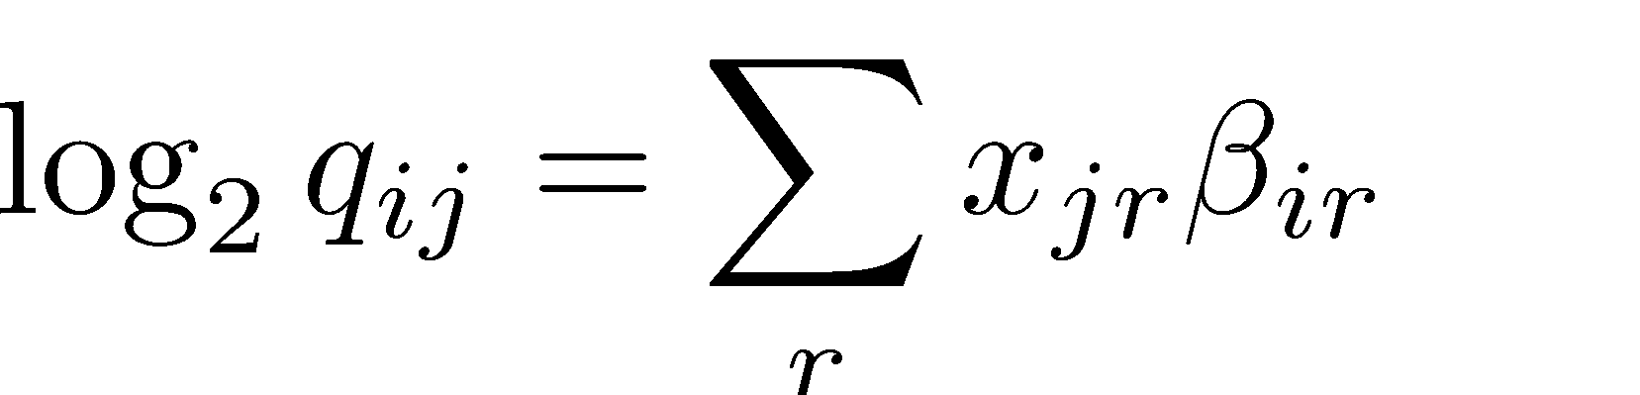
Differences across condition
i indexes genes
log2 of RNA abundance (controlling for library size)
gene i, sample j
r indexes coefficients: r = 0 Intercept r = 1 condition B vs A
j indexes samples: x₁₁ = 0 : sample 1 is in condition A x₄₁ = 0 : sample 4 is in condition B
Notes:
K_{ij} &\sim \text{NB}(s_{ij} q_{ij}, \alpha_i ) \\
\log_2 q_{ij} &= \sum_r x_{jr} \beta_{ir}

Slide 41
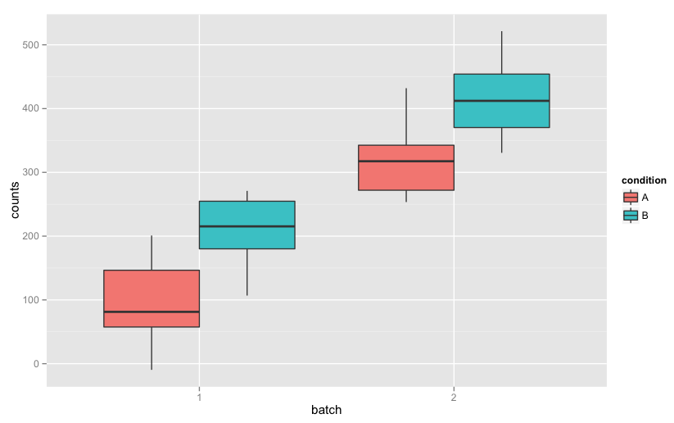
Controlling for different batches
Using a design formula: ~batch + condition, adds coefficients that control for batch differences
If batches are unknown, possible to detect these with other methods: svaseq, RUVSeq
Notes:
data <- data.frame(counts=rnorm(10*4, rep(c(100,200,300,400),each=10), 50), batch=factor(rep(1:2,each=2*10)), condition=factor(rep(c("A","B","A","B"), each=10)));ggplot(data, aes(x=batch, y=counts, fill=condition)) + geom_boxplot()

Slide 42
Differences across condition
Describe experiment with formula, e.g.: ~batch + condition
Formulae are a convenient and powerful tool
log₂ q1 1 0 0
log₂ q2 1 0 0
log₂ q3 1 1 0
log₂ q4 = 1 1 0
log₂ q5 1 0 1
log₂ q6 1 0 1
log₂ q5 1 1 1
log₂ q6 1 1 1
Intercept
batch2
conditionB

Slide 43
Differences across condition
Describe experiment with formula, e.g.: ~batch + condition
Formulae are a convenient and powerful tool
log₂ q1 1 0 0
log₂ q2 1 0 0
log₂ q3 1 1 0
log₂ q4 = 1 1 0
log₂ q5 1 0 1
log₂ q6 1 0 1
log₂ q5 1 1 1
log₂ q6 1 1 1
Intercept
batch2
conditionB
results(dds, name="condition_B_vs_A")

Slide 44
Differences across condition
Describe experiment with formula, e.g.: ~condition
Formulae are a convenient and powerful tool
log₂ q1 1 0 0
log₂ q2 1 0 0
log₂ q3 = 1 1 0
log₂ q4 1 1 0
log₂ q5 1 0 1
log₂ q6 1 0 1
Intercept
conditionB
conditionC
results(dds, contrast=c("condition","B","A"))

Slide 45
Differences across condition
Describe experiment with formula, e.g.: ~condition
Formulae are a convenient and powerful tool
log₂ q1 1 0 0
log₂ q2 1 0 0
log₂ q3 = 1 1 0
log₂ q4 1 1 0
log₂ q5 1 0 1
log₂ q6 1 0 1
Intercept
conditionB
conditionC
results(dds, contrast=c("condition","C","A"))

Slide 46
Differences across condition
Describe experiment with formula, e.g.: ~condition
Formulae are a convenient and powerful tool
log₂ q1 1 0 0
log₂ q2 1 0 0
log₂ q3 = 1 1 0
log₂ q4 1 1 0
log₂ q5 1 0 1
log₂ q6 1 0 1
Intercept
conditionB
conditionC
results(dds, contrast=c("condition","C","B"))

Slide 47
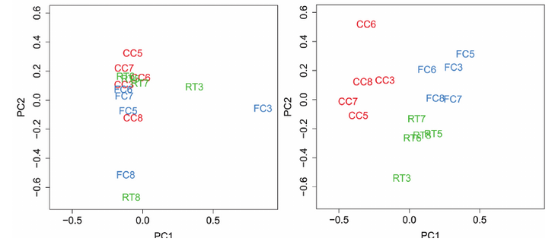


QC and remedies for batch effects
RUV
Include known batch in design
Estimate biases during quant
MultiQC inspection
Factor analysis (after quant)
Salmon

Slide 48
RNA (cDNA) short read sequencing
High dynamic range:
RNA transcript
5’
(AAA)
4 fragments
RNA fragment
fragmentation
5’
RNA / cDNA
5’
15 fragments
hexamer priming
double strand cDNA
5’
cDNA
size selection &
5’
PCR amplification
4,000 fragments
…
ACGTACGT…
sequencing: produces a “fragment”
…TTAACCGG
Gene A
pair of sequenced reads
Notes:
“As opposed to hybridization…”
“…Also we are able to discovery new transcripts, and there is other information I’ll come to later”

Slide 49
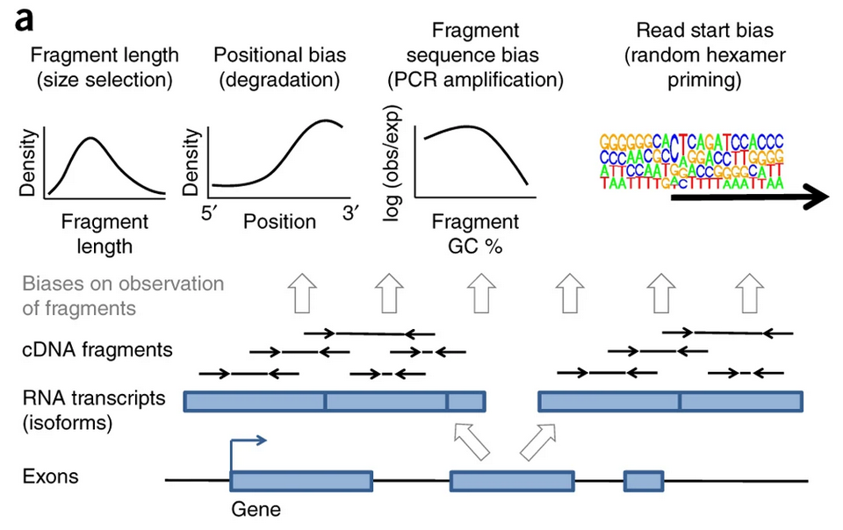
Technical biases corrected by Salmon
?
--posBias --gcBias --seqBias
(default)

Slide 50
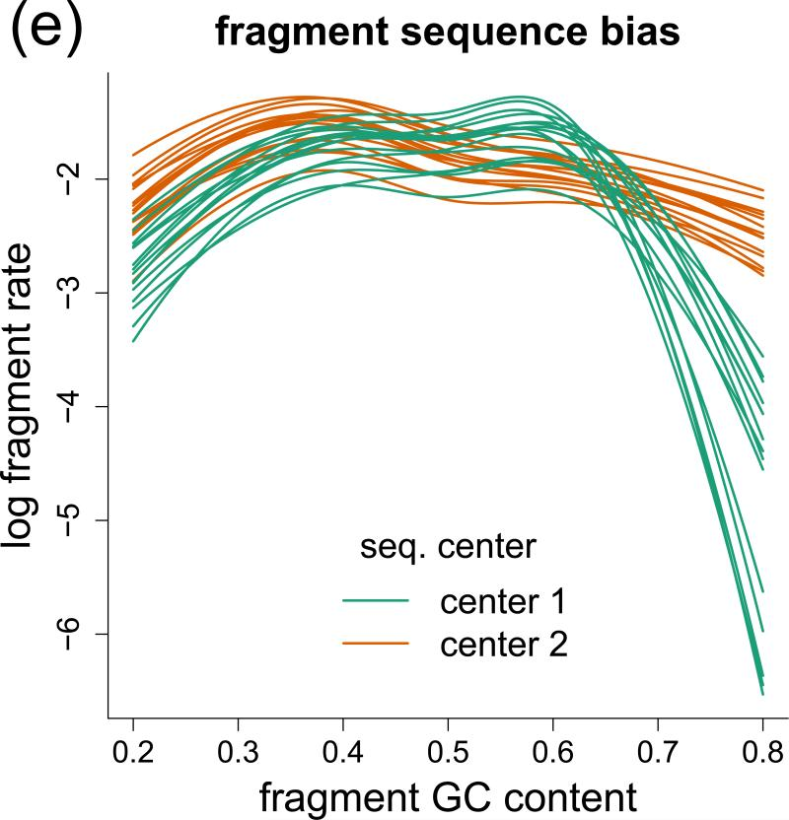
Fragment sequence bias
Shown is after removing “hexamer bias” / “sequence bias”
Can be attributed to differences in PCR amplification
Sample- and batch-specific in comparison to “sequence bias” which doesn’t vary much across samples
Love, Hogenesch, & Irizarry, “Modeling of RNA-seq fragment sequence bias reduces systematic errors in transcript abundance estimation” (2016) PMC5143225

Slide 51
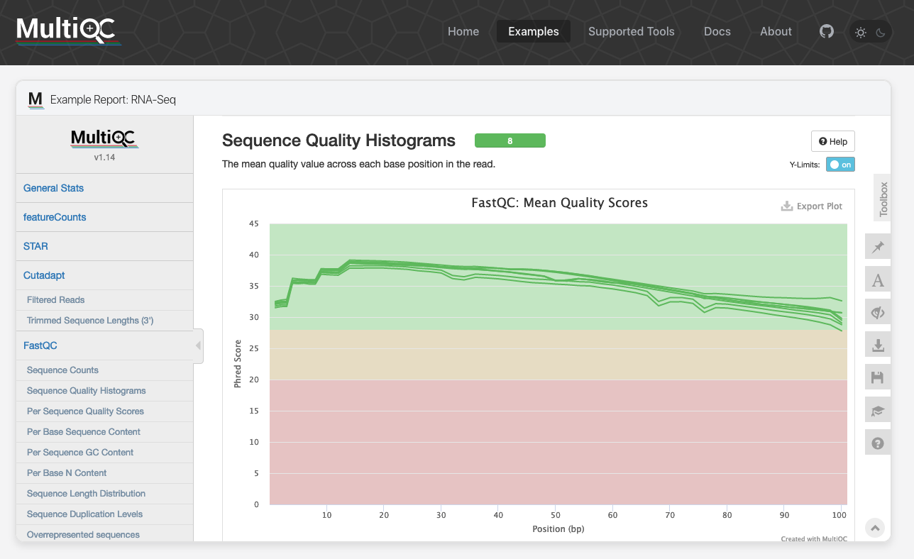

Slide 52
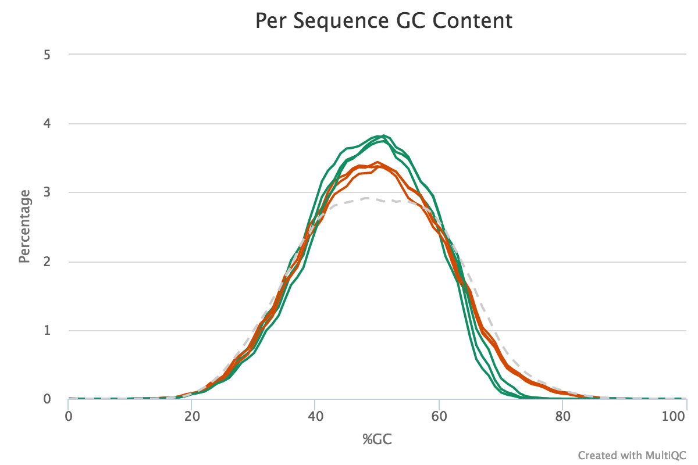
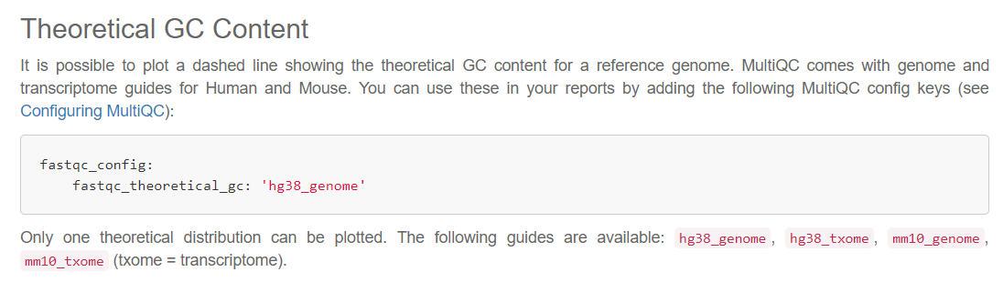
We have a plugin for MultiQC
Read GC content (not fragment)

Slide 53
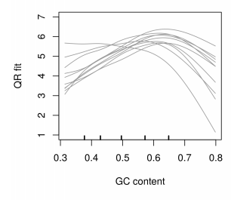
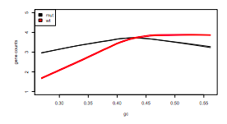
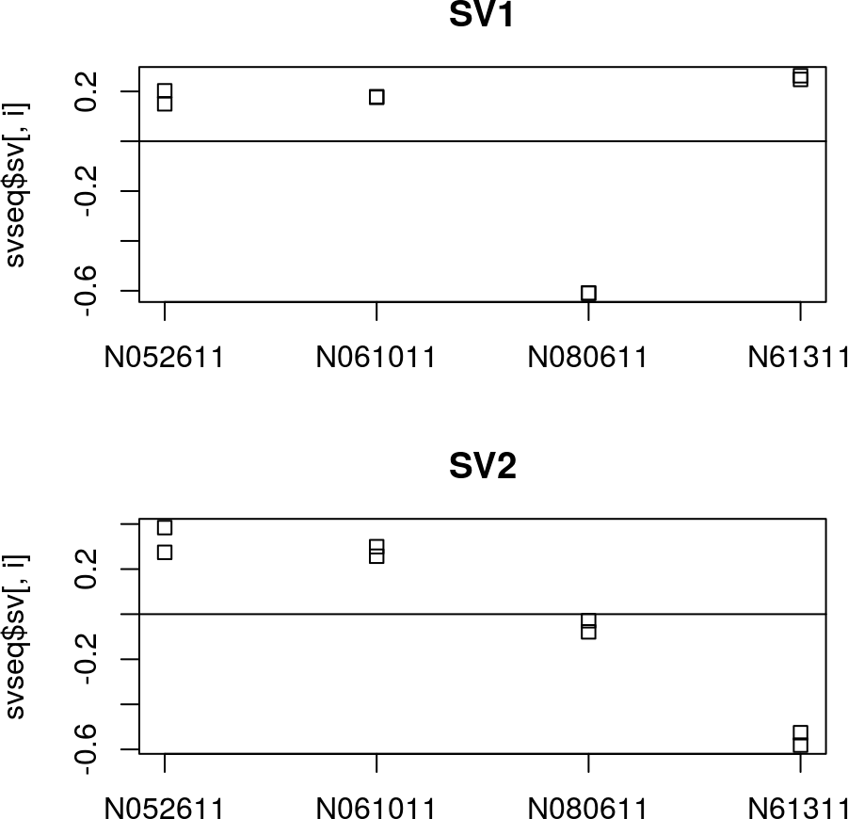
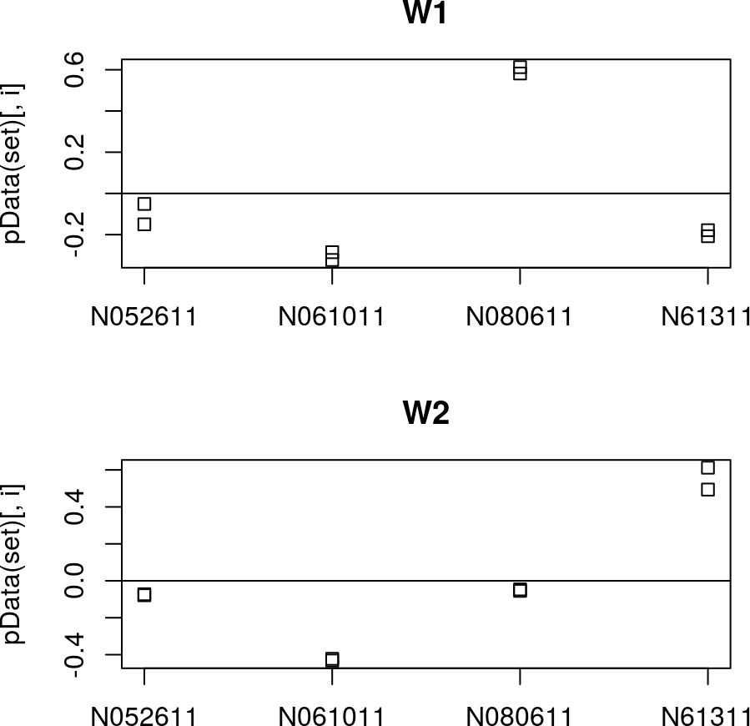
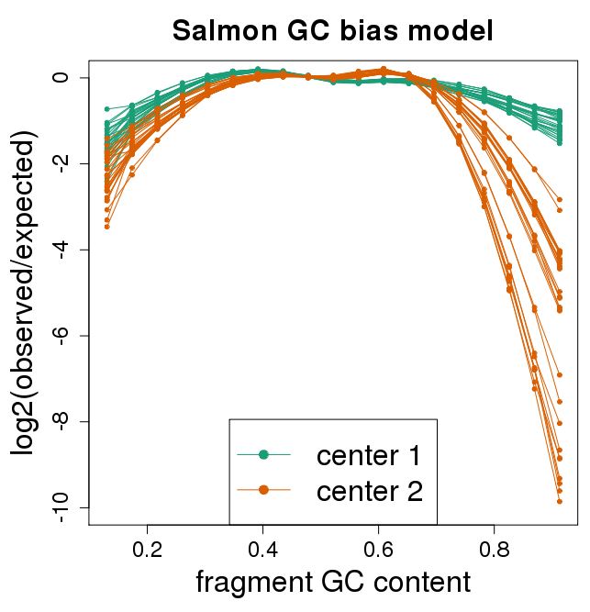
Different types of normalization
cqn
EDASeq
model counts on
covariates (length, GC)
offsets
svaseq
RUVSeq
add to design
factor analysis on residuals of: log counts ~ biological
tximport
normalization
Length biases and…
Salmon bias correction
offsets

Slide 54
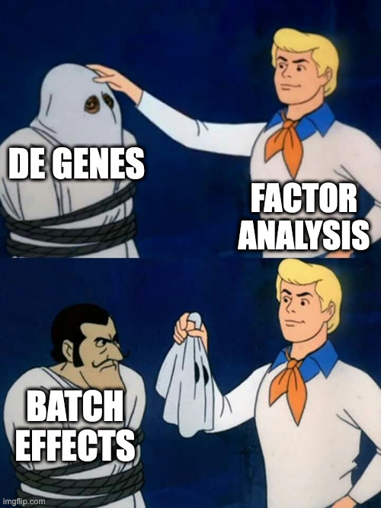

Slide 55
Biology intro
RNA-seq count table
Batch effects and QC
Quantification (reads → count table)
Import into Bioconductor

Slide 56
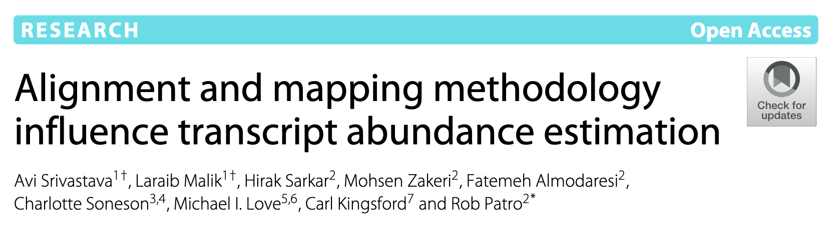
Lightweight quantifiers
Sailfish: Patro et al (2014), kallisto: Bray et al (2016), Salmon: Patro et al (2017)
Salmon maps reads to transcriptome with RapMap: Srivastava et al (2016)
Elements of mapping algorithm use ideas from kallisto: Bray et al (2016): (1) skipping ahead to find Next Informative Position (NIP) and (2) defining the consensus as ∩ of transcript sets from all hits
Salmon maps all PE reads, useful for estimating bias
transcriptome
fragment
transcript
PE reads
k-mers
k-mers
P(fragment | transcript)
GC content of every inferred fragment, adjust effective tx lengths, pass to DE tools
Notes:
RapMap makes use of different data structure and search strategy;
uses variable length matches (matching context determined by quality of read) which leads to dynamic, context-dependent NIPs and allows meaningful estimation of “match coverage” (though not currently used by Salmon);
consensus mechanism requires orientation consistency of hits;
transcript sets derived _from_ positions --- positional information is designed to be a fundamental part of all mappings returned by RapMap by default (pseudoalignment can decode that information, but default strategy extracts the set of “compatible” transcripts without txp-level positional information)

Slide 57
Steps for running Salmon
reference transcriptome (Gencode v99)
RNA-seq samples
index
fastq.gz
Salmon index
quant
est. counts, TPM, effective lengths
quant dir

Slide 58
Recommend Salmon with Snakemake
RNA fragment sequences
Key:
Input Arguments Output Wildcard
rule salmon_quant:
input:
r1 = "/pine/scr/m/i/milove/{sample}_1.fastq.gz",
r2 = "/pine/scr/m/i/milove/{sample}_2.fastq.gz",
index = "/proj/milovelab/anno/gencode.vXYZ-salmon_1.3.0"
output:
"quants/{sample}/quant.sf"
params:
dir = "quants/{sample}"
shell:
"{SALMON} quant -i {input.index} -l A -p 8 --gcBias "
"--numGibbsSamples 30 --thinningFactor 100 "
"-o {params.dir} -1 {input.r1} -2 {input.r2}"
rule all:
input: expand("quants/{run}/quant.sf", run=RUNS)
rule salmon_index:
input: "{ANNO}/gencode.vXYZ.transcripts.fa.gz"
output: directory("{ANNO}/gencode.vXYZ-salmon_1.3.0")
shell: "{SALMON} index --gencode -p 8 -t {input} -i {output}"
Reference transcripts (GENCODE, Ensembl, etc.)
My Salmon Snakemake file (you can find this later on my website, under Software)

Slide 59
Biology intro
RNA-seq count table
Batch effects and QC
Quantification (reads → count table)
Import into Bioconductor

Slide 60


Packages for data import

Slide 61


estimated abundance
true abundance

Slide 62
How does tximeta work?
Source: Gencode v38
RNA-seq
(FASTQ)
Reference Txome (FASTA)
quantify
Index
Hash value
Quant dir

Slide 63
Gencode v38
RNA-seq
Quant dir
se <- tximeta(coldata)
## importing quantifications
## reading in files with read_tsv
## found matching transcriptome:
## [ gencode - Homo sapiens - version 38 ]
## loading existing TxDb
## generating transcript ranges
## fetching genome info
Summarized Experiment

Slide 64
Bioconductor has rich objects
metadata:
genome build,
gene model database version,
creation time,
package version, etc.
colData: phenotype table
DESeqDataSet
(SummarizedExperiment)
rowRanges:
chr, range, strand,
for each gene
count
matrix

Slide 65
Extra slides

Slide 66
Bioconductor help
Vignettes:
> browseVignettes("DESeq2") > vignette("DESeq2")
Type ? then the function name:
> ?results

Slide 67
Bioconductor help
results package:DESeq2 R Documentation
Extract results from a DESeq analysis
Description:
‘results’ extracts a result table from a DESeq analysis giving
base means across samples, log2 fold changes, standard errors,
test statistics, p-values and adjusted p-values; ‘resultsNames’
returns the names of the estimated effects (coefficents) of the
model; ‘removeResults’ returns a ‘DESeqDataSet’ object with
results columns removed.
Usage:
results(object, contrast, name, lfcThreshold = 0,
altHypothesis = c("greaterAbs", "lessAbs", "greater", "less"),
listValues = c(1, -1), cooksCutoff, independentFiltering = TRUE,
alpha = 0.1, filter, theta, pAdjustMethod = "BH",
format = c("DataFrame", "GRanges", "GRangesList"), test, addMLE = FALSE,
tidy = FALSE, parallel = FALSE, BPPARAM = bpparam())
...
Arguments:
object: a DESeqDataSet, on which one of the following functions has
already been called: ‘DESeq’, ‘nbinomWaldTest’, or
‘nbinomLRT’
contrast: this argument specifies what comparison to extract from the
‘object’ to build a results table. one of either:
• a character vector with exactly three elements: the name
of a factor in the design formula, the name of the
numerator level for the fold change, and the name of the
denominator level for the fold change (simplest case)

Slide 68
Bioconductor help
Value:
For ‘results’: a ‘DESeqResults’ object, which is a simple subclass
of DataFrame. This object contains the results columns:
‘baseMean’, ‘log2FoldChange’, ‘lfcSE’, ‘stat’, ‘pvalue’ and
‘padj’, and also includes metadata columns of variable
information....
...
References:
Richard Bourgon, Robert Gentleman, Wolfgang Huber: Independent
filtering increases detection power for high-throughput
experiments. PNAS (2010), <URL:
http://dx.doi.org/10.1073/pnas.0914005107>
See Also:
‘DESeq’
Examples:
## Example 1: simple two-group comparison
dds <- makeExampleDESeqDataSet(m=4)
...

Slide 69
Looking up help for objects
> class(dds)
[1] "DESeqDataSet"
attr(,"package")
[1] "DESeq2"
> ?DESeqDataSet
> help(package="DESeq2", help_type="html")

Slide 70



How to get help – don't email developers!
https://support.bioconductor.org

Slide 71

How to get help

Slide 72
Statistical power review
False positive rate (𝛼 under 𝐻₀): of the null, how many positives?
False discovery rate: of the positives, how many false positives?
Power (sensitivity): of the non-null, how many positive?
?
?
?
?
?
?
 | true:
test: | Nulls | Alternatives
Negative | true negative | false negative
Positive | false positive | true positive
seek to avoid
seek to avoid

Slide 73



Statistical power
Why not use a (simple) t-test on log scaled counts?
DESeq2
t-test

Slide 74


Bioc pkg: RNASeqPower
?
?
varying the count
varying the dispersion

Slide 75
Brief comparison of DE methods

Slide 76

NB simulation
"Robustly detecting differential expression in RNA sequencing data using observation weights"
Xiaobei Zhou, Helen Lindsay and Mark D. Robinson (2014)

Slide 77


Nonparametric simulation
10% FDR
at reported
10% FDRD
15% FDR
at reported
10% FDR
Benidt & Nettleton (2015)

Slide 78


Schurch et al 2016: "How many biological replicates are needed in an RNA-seq experiment?" Generated a "highly replicated" yeast RNA-seq (n=42)
PMC4878611
edgeR TPR over per-group sample size
null comparisons (within group)
power analysis (DE across group)
FPR
100 simulations, boxplot: 75%, whisker: 95%
Conclusion: Most methods have low FPR in at least 95/100 null comparisons

Slide 79

https://commons.wikimedia.org/wiki/File:Heterozygous.jpg

Slide 80

rSNP
tSNP, or eSNP
eQTL
Castel, S.E., Aguet, F., Mohammadi, P. et al. A vast resource of allelic expression data spanning human tissues. Genome Biol 21, 234 (2020). https://doi.org/10.1186/s13059-020-02122-z
Notes:
to detect cis-acting regulatory SNPs (rSNPs) in individuals heterozygous for a transcribed SNP (tSNP)
https://www.ncbi.nlm.nih.gov/pmc/articles/PMC4372992/

